Slide 1

Introduction to Frameworks - 17
Orion Innovation
Company Overview

Slide 2
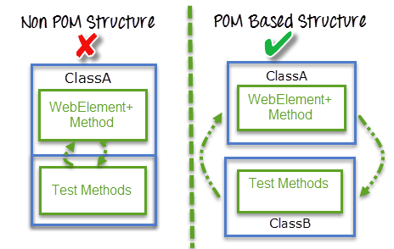
Previous Lesson’s Highlights
Page Object Model (POM)
Source: [1] POM Structure

Slide 3
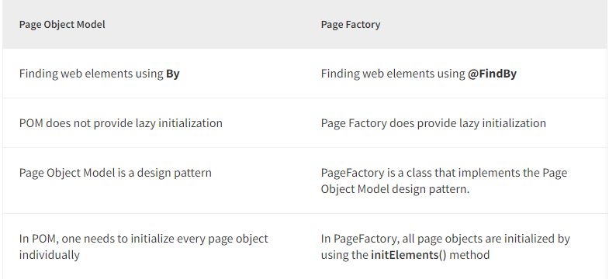
Previous Lesson’s Highlights
Page Object Model and Page Factory
Source: [2] Page Object Mode and Page Factory

Slide 4
Content
Introduction to Frameworks

Slide 5
What is a Framework?
A framework defines a set of rules or best practices that we can follow in a systematic way to achieve the desired results.
Source: [3] Definition of Framework

Slide 6
Why do we need the Selenium?
Easy code maintenance
Increase in code re-usage
Higher code readability
Reduced script maintenance cost
Reduced tests’ time execution
Reduced human resources
Easy reporting
Source: [3] Advantages of Selenium

Slide 7
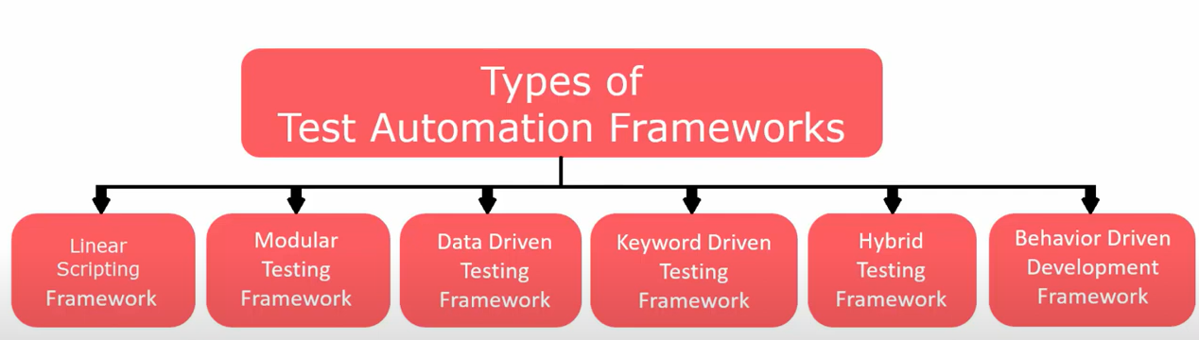
Test Automation Frameworks
Source: [4] Test Automation Frameworks

Slide 8
1. Linear Scripting Framework It is also known as the ‘Record and Playback’ framework.
It is a basic level test automation framework that is in the form of ‘Record and Playback’ in a linear fashion.
It is also known as the ‘Record and Playback’ framework.
It is used to test small-sized applications.
In this type, the creation, and execution of test scripts are done individually for each test case individually.
QA team capture each test step such as browsing, navigation, user inputs, enforcing checkpoints. QA team then play the scripts to carry out the tests.
Source: [3] Linear Scripting Framework

Slide 9
1. Linear Scripting Framework
Advantages of Linear Scripting Automation Framework:
Can generate test scripts (Record and playback) without planning much or consume much time
Coding knowledge is not required
A quick way to generate test scripts
Disadvantages of Linear Scripting Automation Framework:
Lack of reusability due to autogenerated scripts
Hard coding the data doesn’t allow us to run with multiple data sets
Maintenance is high – It requires a lot of effort to do even small changes.
Source: [3] Linear Scripting Framework

Slide 10
2. Modular Testing Framework Also known as modularity framework or module-based framework.
Concept
Break down the application under test into smaller, independent modules.
Create test scripts for each module individually.
Implementation
Divide the application into multiple modules.
Write individual test scripts for each module.Combine individual scripts into larger test scripts using a master script.
Master script invokes individual modules for end-to-end test scenarios.
Purpose
Build an abstraction layer to protect the master script from changes in individual tests.
Features
Function libraries are created for reusable code.
Source: [3] Modular Testing Framework

Slide 11
2. Modular Testing Framework
Advantages
Better scalability and easier to maintain due to breaking down the complete application into different modules
Can write test scripts independently
Changes in one module bring no or low impact on the other modules
Disadvantages
Takes more time to analyze the test cases and to identify reusable flows
Due to hardcoded data in the test scripts, it’s not possible to sue multiple data sets.
Requires coding skills to set up the framework
Source: [3] Modular Testing Framework

Slide 12
3. Data Driven Framework
Concept:
Separates test script logic from test data.
Allows test scripts to run with different sets of test data.
Implementation:
Test data is stored in external files or resources (e.g., MS Excel, MS Access, SQL Database, XML files).
Test scripts connect to these external resources to retrieve test data.
Advantages:
Enables test scripts to work with various data sets.
Reduces the number of test scripts compared to module-based frameworks.
Provides more test coverage with reusable tests.
Offers flexibility in test execution by changing only the input test data.
Reliable as tests are not impacted by changes in test data.
Disadvantages:
Requires programming knowledge to develop test scripts.
Preparing and managing test data can be time-consuming.
Source: [3] Data Driven Framework

Slide 13
4. Keyword Driven Testing Framework It is also known as table-driven testing or action word-based testing.
Concept:
Uses a table format to define keywords or action words for each function or method.
Executes automation test scripts based on keywords specified in an Excel sheet.
Implementation:
Testers develop scripts using keywords.
Main class contains logic to read keywords and call the required actions from the Excel sheet.
Similar to data-driven testing but focuses on actions rather than data.
Advantages:
Testers with minimal programming knowledge can write test scripts.
Promotes code reusability by pointing different scripts to the same keywords.
Test scripts remain unchanged even if the application changes.
Tests can be designed before the application is fully developed.
Test scripts work independently of the application under test with minimal modifications.
Not dependent on specific test tools.
Disadvantages:
Takes more time to design the framework.
Initial setup cost is high.
Requires employees with good test automation skills for implementation.
Source: [3] Keyword Driven Testing Framework

Slide 14
5. Hybrid Driven Testing Framework:
Hybrid Test automation framework is the combination of two or more frameworks mentioned previously.
Source: [3] Hybrid Driven Testing Framework

Slide 15
6. Behavior Driven Development Testing Framework
Purpose
Creates a platform for active participation from Business Analysts, Developers, Testers, etc.
Requires increased collaboration between Development and Test Teams.
Does not require users to know a programming language.
Implementation
Uses non-technical, natural language to create test specifications.
Tools
JBehave, Cucumber, etc.
Source: [3] Behavior Driven Development Testing Framework

Slide 16
7. Library Architecture Testing Framework Library Architecture Testing framework aka “Structured Scripting” or “Functional Decomposition”
Concept:
Builds on the modular framework with additional advantages.
Identifies and groups common tasks into functions.
Stores these function groups in a library.
Reuses libraries in test scripts to create new test cases.
Advantages:
Simplifies script maintenance.
Enhances scalability.
Promotes reusability of function libraries.
Disadvantages:
Requires coding skills.
Takes more time to prepare test scripts.
Fixed test data is hardcoded within the scripts.
Source: [3] Library Architecture Testing Framework

Slide 17
Examples
Modular Testing Framework
Example: JUnit (Java)
Description: In this framework, tests are written in modules. Each module represents a specific function of the application under test, allowing for easier maintenance and reusability. For instance, JUnit allows the creation of test cases as independent modules, which can be combined to create comprehensive test suites.
Data Driven Testing Framework
Example: Apache POI with TestNG (Java)
Description: This framework separates test scripts from test data. Test data is stored in external files like Excel, CSV, or databases, and the test scripts read this data during execution. Apache POI can be used to read data from Excel files, and TestNG can be used to drive the tests based on this data.
Keyword Driven Testing Framework
Example: Selenium with Robot Framework
Description: This framework uses keywords to represent actions that need to be performed on the application under test. The keywords are defined in external files, making it easy for non-technical users to create test cases. The Robot Framework allows users to define keywords and reuse them across different test cases.
Source: [5] Usage examples of Test Automation Framework

Slide 18
Examples
Behavior Driven Development (BDD) Framework
Example: Cucumber with Selenium
Description: BDD frameworks use natural language to define test cases, making them more understandable to all stakeholders, including non-technical members. Cucumber allows writing test cases in Gherkin language, which can then be mapped to Selenium code to perform the actual testing. This ensures that the tests are aligned with the business requirements and are easy to read and understand.
Library Architecture Testing Framework
Example: Selenium WebDriver with Custom Libraries
Description: This framework is built around a library that contains common functions or utilities. The test scripts call these library functions, which helps in reducing code duplication and enhancing maintainability. For instance, Selenium WebDriver can be used to create a library of reusable functions for various web interactions, which can then be used across different test scripts.
Linear Scripting Framework
Example: Selenium IDE
Description: This is the simplest form of test automation framework. Test scripts are recorded in a linear fashion, usually by capturing user actions as they interact with the application. Selenium IDE is a tool that allows users to record, edit, and playback test cases directly in the browser. It is ideal for small projects and quick prototyping.
Source: [5] Usage examples of Test Automation Framework

Slide 19
Examples
Hybrid Testing Framework
Example: Selenium WebDriver with TestNG and Apache POI
Description: A hybrid framework combines the best features of various testing frameworks. For example, using Selenium WebDriver for interacting with the web application, TestNG for test management and execution, and Apache POI for reading test data from Excel files. This approach leverages the modular, data-driven, and keyword-driven techniques for maximum flexibility and efficiency.
Source: [5] Usage examples of Test Automation Framework

Slide 20
References
[1] https://www.guru99.com/page-object-model-pom-page-factory-in-selenium-ultimate-guide.html
[2] https://www.browserstack.com/guide/page-object-model-in-selenium
[3] https://www.softwaretestingmaterial.com/types-test-automation-frameworks/
[4] https://www.youtube.com/watch?app=desktop&v=3hHL-BhBW4I
[5] https://chatgpt.com/

Slide 21
Thanks

